Slide 2
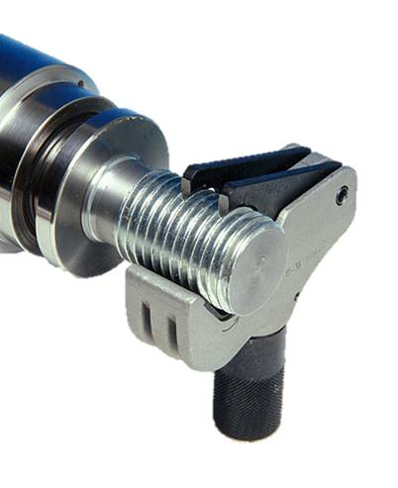
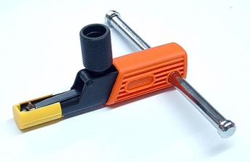
UNIVERSEL
THREAD
RESTORER
NES®
NES is a complete line of tools, specially designed to repair any kind of defect threads and is an ideal tool to save time and money! This tool can mend any type of threads, internal or external, any diameter, pitch, fine, coarse, left or right hand threads. This “All-rounder” replaces alone over 150 single pieces and is easy and comfortable to use.
For any screw
Easy, fast and comfortable application
Replace over 150 single rethreading dies
EXTERNAL
MINI | MIDI | SMALL | GIANT | SET 1000 | SET 1300
4-13 mm | 4 – 18 mm | 17 – 38 mm | 35 – 152 mm | 4 – 38 mm | 4 – 152 mm
INTERNAL*
7210 | 7220 | 7230 | SET 1007 | SET 1008 | SET 1036
8-11 mm | 12 – 16 mm | 16 – 20 mm | 8 – 20 mm | 8 – 32 mm | 22 – 168 mm
* Available in further sizes

Slide 3
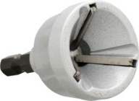
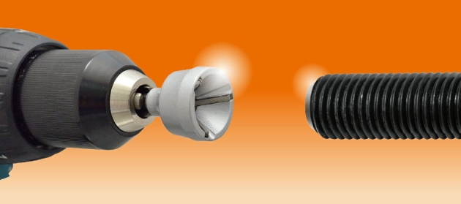
UNI
REAMER®
UNIVERSAL
DEBURRING TOOL
Uni Reamer repairs damaged screws in seconds. It is operated by a hand drill or cordless screwdriver and can be used for all steel grades. It is applicable to any rounds, bars, threaded rods and screws, etc. and any materials, like stainless or hardened steel, mild steel, copper, brass, wood, fiberglass and hard plastic.
Uni Reamer simplifies the repair process and saves your time and money.
Cat. No | Diameter, mm | Torque | Blade | Degree of Hardness | Max. rotation speed | Availability
600 000 | 3 - 19 mm | 260 NM | H.S.S.E | RC 60 | 400 rpm | Single
600 010 | 3 – 19 mm | 260 NM | Tungsten | RC 72+ | 400 rpm | Single
600 020 | 13 – 35 mm | 260 NM | Tungsten | RC 72+ | 150 rpm | Single

Slide 4
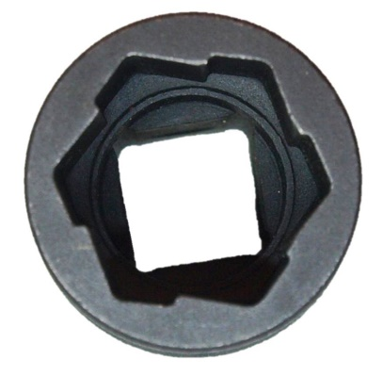
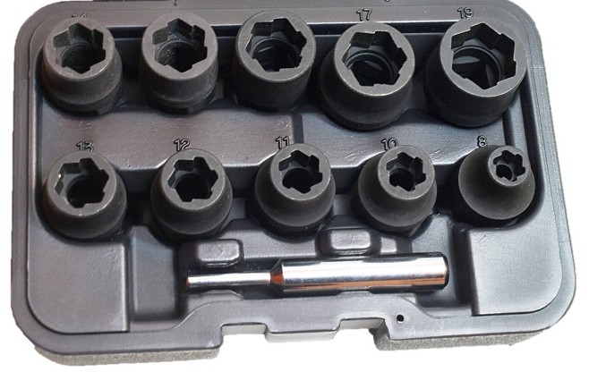
UNIVERSAL
SUPER GRIP
SOCKET
SUPER
GRIP®
Super Grip is a universal socket, which enable you to release and tight most of corroded and damaged nuts. The special profile of socket bites fully into surface of the nut, which results in non-slip gripping between socket and corroded or damaged nuts. It’s enable you to crack the wheel lugs and most of wheel bolt locks. The tool is extra durable due to high-quality material (CrMo).
For 6, 8 & 12 socket head cap screws
Suitable to use for hand tool and impact screwdriver with ½ "drive!​
​
Cat. No | Content | Diameter, mm | Material | Degree of Hardness | Weight, g.
530 500 | 10 Nuts + Punch Bar | 8, 10-17, 19 | CrMo | 45 - 48 HRC | 950

Slide 5
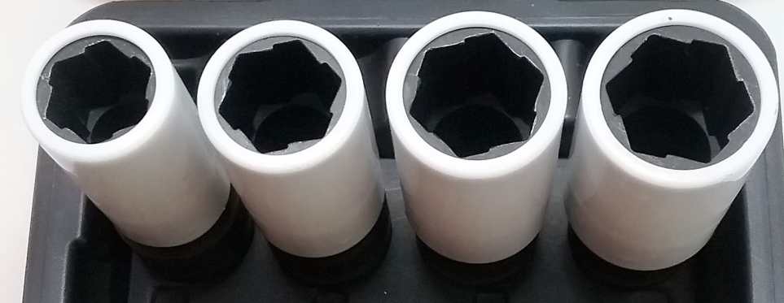
SUPER
GRIP DS®
UNIVERSAL
SUPER GRIP
SOCKET WITH
PROLONGED BODY
Super Grip is a universal socket, which enable you to release and tight most of corroded and damaged nuts. The special profile of socket bites fully into surface of the nut, which results in non-slip gripping between socket and corroded or damaged nuts. It’s enable you to crack the wheel lugs and most of wheel bolt locks. The tool is extra durable due to high-quality material (CrMo).
For wheel bolts and most of rim locks.
For damageable rims (Alloy rim)
For 6, 8 & 12 socket head cap screws
Suitable to use for hand tool and impact screwdriver with ½” drive!​
Cat. No | 530 600
Content, sizes in mm | 17, 19, 21, 22
Length, mm | 83,5
Weight, g. | 1200

Slide 6
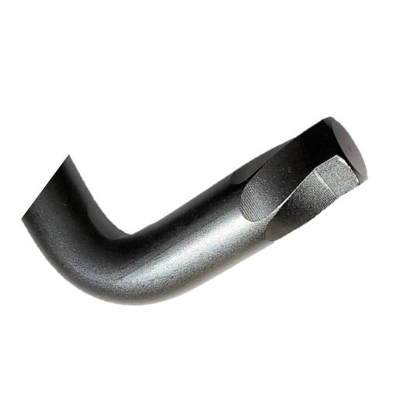
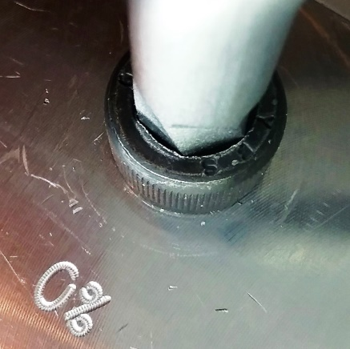
UNIVERSAL
SUPER GRIP
HEX-WRENCH
SUPER
GRIP
HEX®
Universal Super Grip Hex-Wrench Key to release and tight of corroded and damaged screw caps. The special profile of the key enable non-slip gripping of corroded, damaged and intact screw caps.
Extra durable due to high quality material (Carbon Steel)
Suitable for any professional application
9-pieces set from 1,5 up to 10 mm
Cat. No | Content | Size, mm | Material | Length | Degree of Hardness | Weigth, g
530 700 | 9 Keys | 1,5 - 2 - 2,5 - 3 - 4 - 5 - 6 - 8 - 10 | CrMo | 90 - 230 | 45 - 48 RC | 950

Slide 7
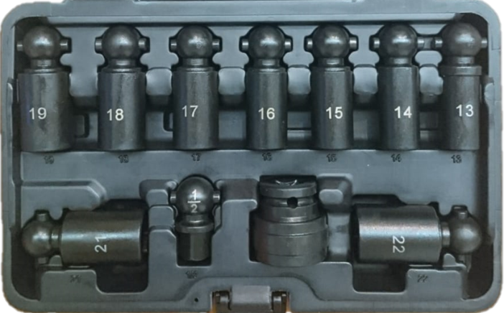
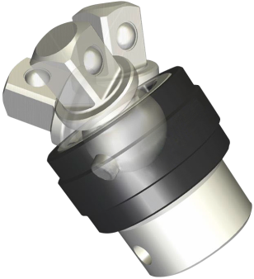
PIVOT
MAGIC
JOINT®
PIVOT MAGIC
JOINTS
Patented Joints with swivel and interchangeable function for working in restricted access areas and around the edge. Suitable to use for hand tool and impact air tool with ½” drive. Maximum torque is 600 NM. Joints have extra durable life due to high quality material (CrMo) with RC 45 -48 and are corrosion-resistant.
9-part socket set for all conventional screw profiles (13 – 19mm & 21-22mm) and an extra square 1/2" adapter for any applicable sockets usage. The fast-release press button is used for simple loosening of the socket.
Cat. No | Content | Size | Max. Torque
530 900 | 9 Sockets | 13 bis 19 mm | 600 NM
 | Adapter | 21 bis 22 mm
 | Bolt Joint
530 910 | Adapter | ½" | 600 NM
 | Bolt Joint

Slide 8
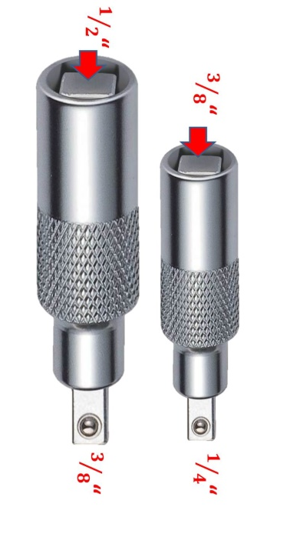
UNIVERSAL
SQUARE ADAPTER
QUADRO ®
ADAPTER
¹/₂“
The mobile square pin makes this adapter adjustable in size and gender, and replaces with this function four regular adapters.
Our 6 - in - 1 Adapter converts
male into female AND
female into male AND
covers two sizes in one ¹/₂“↔ ³/₈" and
¹/₄"↔³/₈" .
Small solution with a great impact,
6 applications in just 2 parts!
³/₈“
³/₈“
¹/₄“
Cat No. | Male | Female | Applications
530 300 | ¹/₂" - ³/₈" ¹/₄" - ³/₈" | ¹/₂" - ³/₈" ¹/₄" - ³/₈" | Ratchet Torque wrench Any square handles Any square keys male or female Any square sockets male or female

Slide 9
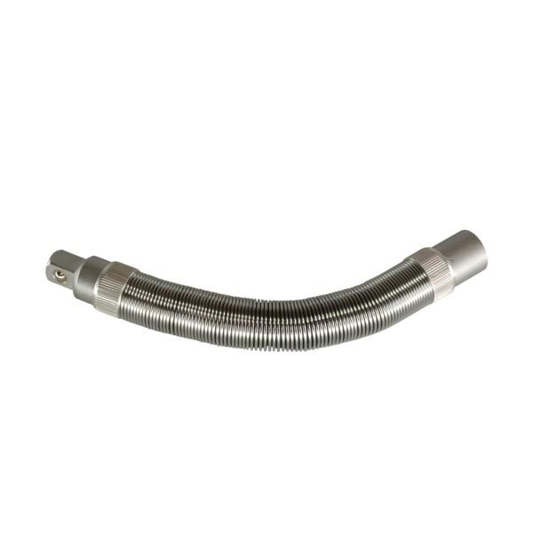
EXTEN-
FLEX®
FLEXIBLE BOLT-EXTENDER
FOR LIMITED ACCESS AREAS
Exten-Flex is recommended for extremely hard to reach fittings combined with high torque values.
Strong external spring directs the single ball joints. With increasing distortion single ball joints get caught more and more, which increase power gear ratio. During the regular spring extender with low torque breaks with increasing power gear ratio, the Exten-Flex Extender proves to sustain high-end strain.
Available in 3/8“ und 1/2“.
Torque up to 350 NM
Robust ball joints
Flexible length, due to reducible number of joints
Cat.No | Name | Size | Length | Max. Torque | Number of joints
FT7000 | Exten-Flex Small | ³/₈" | 235mm | 178NM | 10
FT7500 | Exten-Flex Big | ¹/₂" | 225mm | 350NM | 7

Slide 10
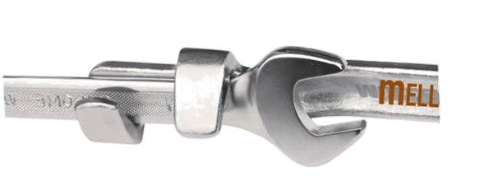
HIGH-END PRFESSIONAL UNIVERSAL
EXTENDER
REJ-IT®
Universal professional extender enables you to release of stubborn bolts in hard to reach areas. It fits any wrench, offset ring spanner etc.
Also suitable for extended pin keys like
scavengers of hexagon,
internal hexagon,
TX,
XZN,
Ribe
etc.
Available in 340mm (car version) and 530mm (truck version).
Universal, robust and secure with great leverage!
Cat.No | Name | Length | Square Socket Size
8000 | UNI-Ex small/ car version | 340mm | ¹/₂"
9000 | UNI-Ex large / truck version | 540mm | 1"

Slide 11
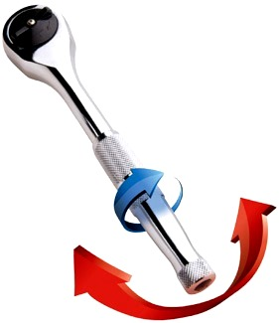
RATCH-IT®
RATCHET FOR TWIST AND SWING
This unique ability means the ratchet is far more efficient than a conventional ratchet, spanner or other wrench having enormous benefits in tight spaces and when loose or awkward nuts & bolts are found.
This coupled with the relatively simple design makes for a tool that is as compact, reliable, and strong as a conventional ratchet for no extra cost.
Cat. No | Name | Size | Length | Torque | Material
530 200 | Ratch-it big | 1/2" DR | 350 NM | Chrom Vanadium | Einzeln / Sets

Slide 12
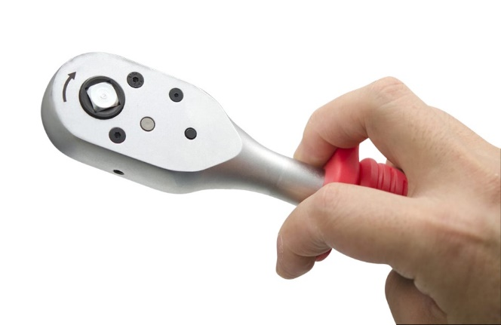
PULL-BACK RATCHET
FOR TIGHT SPACES
RATCH-IT
PRO®
This unique ability means the ratchet is far more efficient than a conventional ratchet, spanner or other wrench having enormous benefits in tight spaces and when loose or awkward nuts & bolts are found. Simple design makes a tool as compact, reliable, and strong as a conventional ratchet for no extra cost.
Patented Pull-Back Drive Action Drive Sockets, without swinging the handle.
48/60 Teeth Push-Through Square Drive Ratchet Mechanism
CrMo Drive Gear and CrV Body, Matt Chrome Plated
two-fingers operation
Cat. No | Name | Size | Length | Torque | Material | Availability
530 010 | Ratch-it Pro short | 3/8" DR | 230 mm | 260 NM | CrMo- Mechanics CrV - Body | Single / Sets
530 030 |  | 1/2" DR | 280 mm | 550 NM
530 020 | Ratch-it Pro long | 3/8" DR | 350 mm | 350 NM
530 040 |  | 1/2" DR | 430 mm | 580 NM

Slide 13
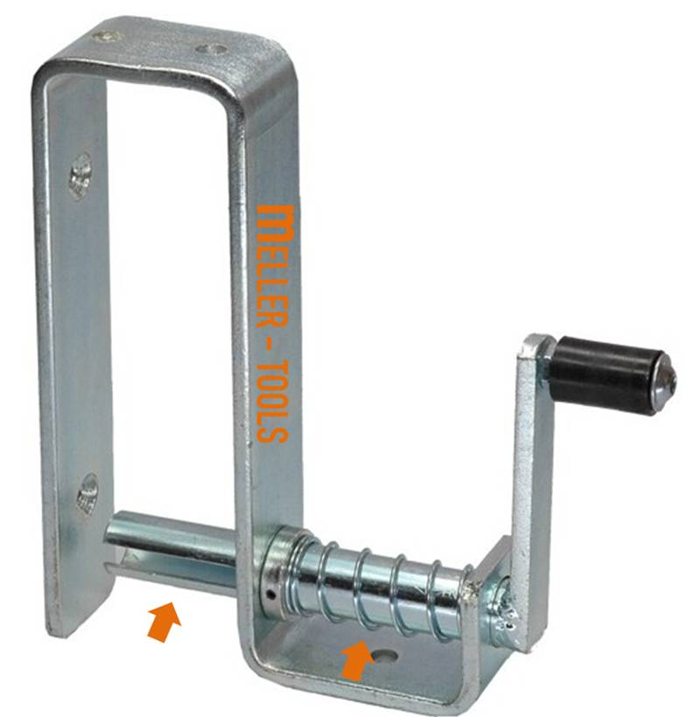
STRAPY®
LASHING STRAP WINDER
Universal spinner for quick and professional roll up of any lashing straps from 8 to 50 mm.
It’s easy to use and to fix. Strapy can be fixed with magnets, stainless steel board or screws n the side of the truck or on any wall.
This smart gadget is zinc-plated, free of corrosion and just resilient.
Your advantage in overview:
Fast roll up of any lashing straps
Can be fixed anyware
Weather-resistant
Cat. No | Material | Belt Width | Fixing System
630100 | Zink-plated | 8 - 50 mm | Magnets, stainless steel board screws

Slide 14
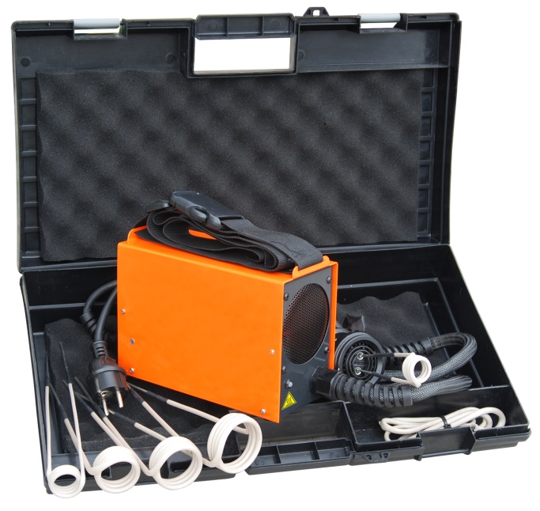
MASTER‘S
INDUCTION HEATER
R2®
The most efficient way to release any stubborn bolts or junctions. R2 heats up in few seconds fire-free above 800°. Set includes 4 coils for majority of applications. Precise, local, safe, fast and efficient!
Possibility to heat parts above 800°
Mobility and flexibility (light and small)
High capacity (high load factor)
Easy operation and multilateral
High efficiency (even and stable heating)
Low operation and operator training costs
Extended live coils with 4mm strength
Hand induction heater R2
is designed for quick, efficient and safe heating of any
metallic parts.
Cat.No | Power | Working Frequency | Efficiency
800 100 | 1,5 kVA | 25 - 60 kHz* | 90% (PFC)

Slide 15
R2
COILS®
COILS ACCESSORY FOR
INDUCTION HEATER R2
Cat. No | Ø, mm | Length, mm | Mode
800 100-15 | 15 | 220 | side or front
800 100-19 | 19 | 220
800 100-20 | 20 | 220
800 100-23 | 23 | 220
800 100-26 | 26 | 220-330
800 100-32 | 32 | 220-330
800 100-38 | 38 | 220-330
800 100-45 | 45 | 220-330
800 100- 03 | Semi- Flexible | 750
800 100 - 02 | Flexible | 800
800 100 - 04 | Flexible - Ceramic | 800 | Extra durable
800100 - 01 | Flexibel | 1000
800 100 - Spot | Focus- Coil NEW!
800 100 - Pad | PAD
800 100 - Set | 15 - 45 | 220 - 330 | 8 Coils side or front

Slide 16
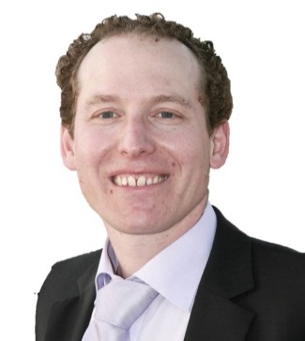
MELLER TOOLS is a professional German supplier of patented repairing tools for Auto-motive, Agriculture and Construction Machinery.
In over 20 years of our history we have provided our innovative high-quality hand tools all over the world. The majority of our customers are based in Europe and USA. Meller Tools suppliers their patented tools also to the German Bundeswehr and US Army.
We offer you a small range of innovative patented hand tools, which would simplify your life substantially and bring a successful result just in a fraction of time, you would usually require for the same job without our tools. Our intention is to provide unique tools in a high quality, which could support you in particular tricky situations. With a single tool we either replace a range of ordinary well-known tools, or we invent a solution tool for previously insolvable situation. Thereby helping you to save your time and money!
No compromise, just solution!
Look forward to support you!
Arie Meller

